Slide 1
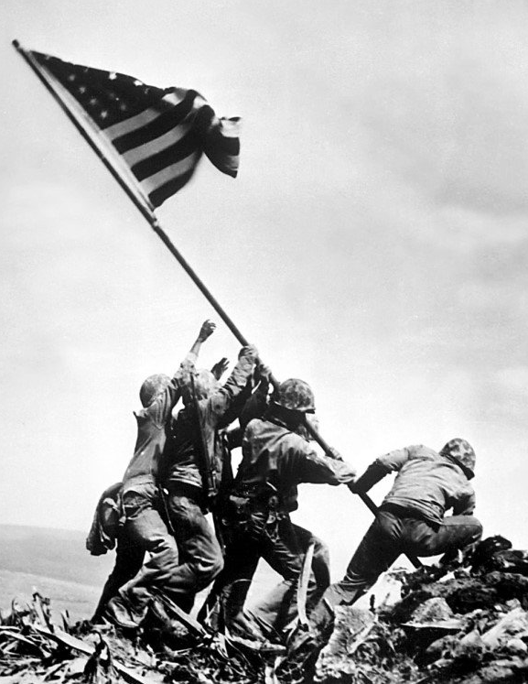
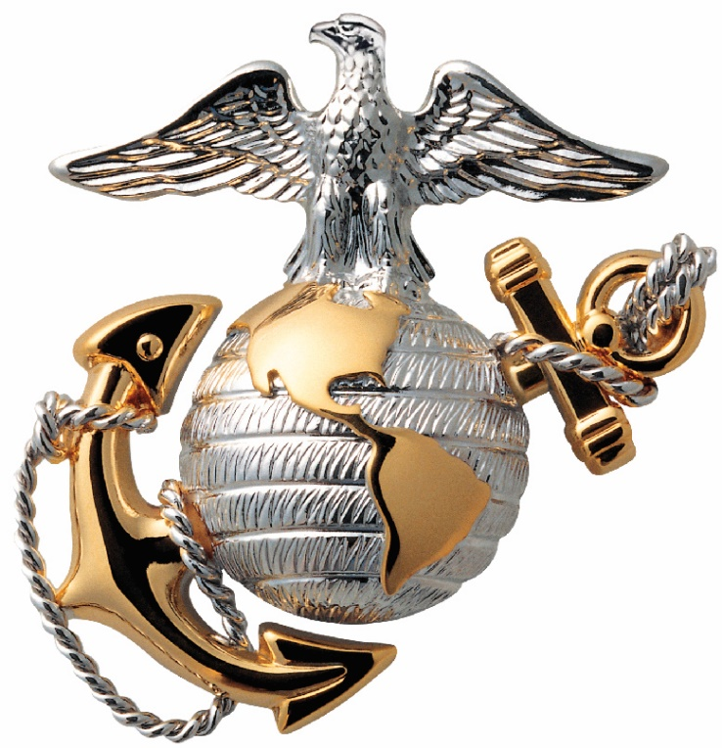
Marines’ Hymn
Welcome to the
Retirement Ceremony of
MGySgt Eberardo “Lalo” Loza
From the halls of Montezuma
To the shores of Tripoli
We fight our country’s battles
In the air, on land and sea.
First to fight for right and freedom,
And to keep our honor clean,
We are proud to claim the title of
UNITED STATES MARINE.
Our Flag’s unfurl’d to every breeze
From dawn to setting sun;
We have fought in every clime and place
Where we could take a gun.
In the snow of far-off northern lands
And in sunny tropic scenes,
You will find us always on the job, the
UNITED STATES MARINES.
Here’s health to you and to our Corps
Which we are proud to serve;
In many a strife we’ve fought for life
And never lost our nerve.
If the Army and the Navy
Ever look on Heaven’s scenes,
They will find the streets are guarded by
UNITED STATES MARINES.
7th Day of July 2023
Camp Lejeune, NC

Slide 2
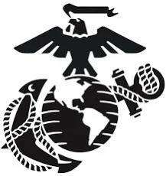
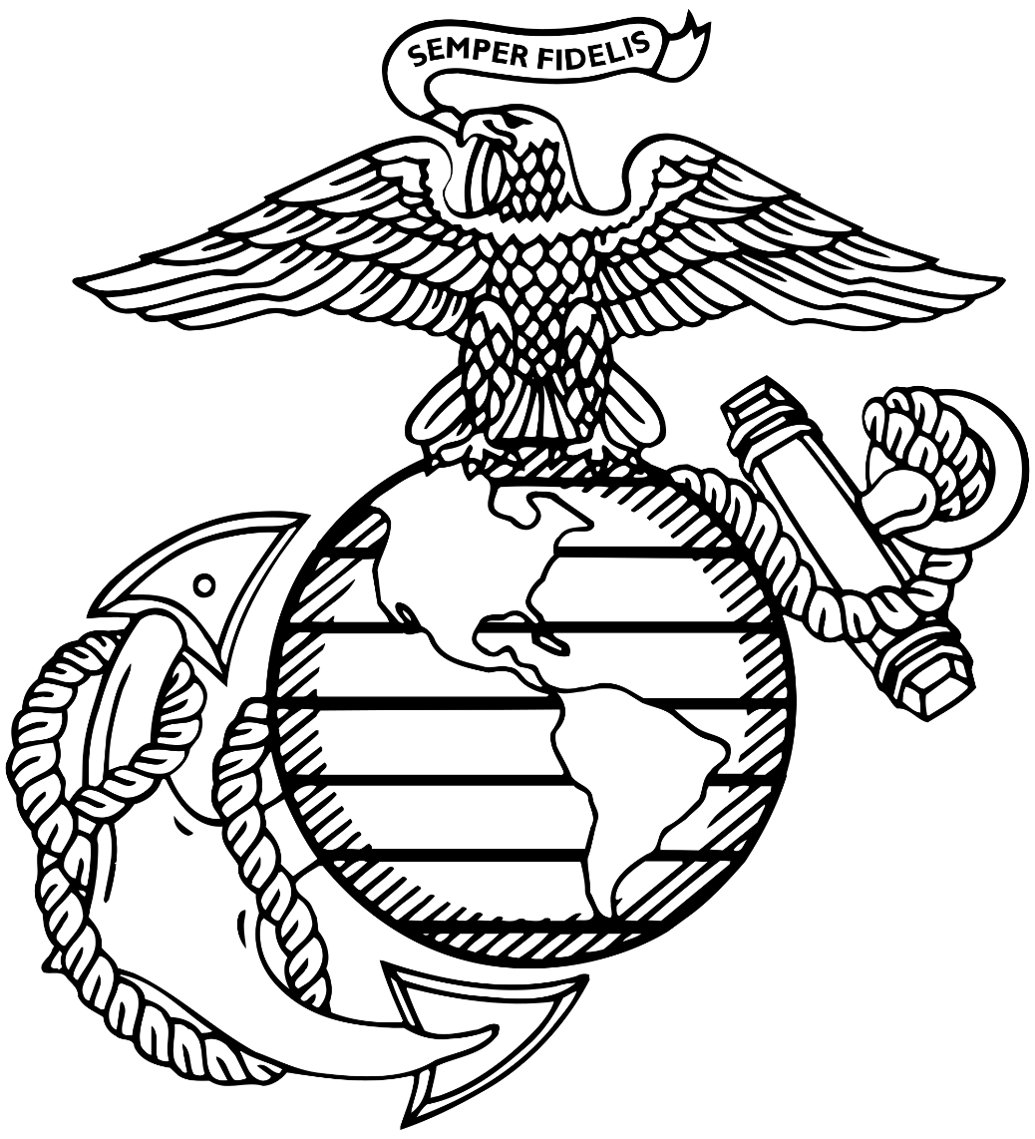
Sequence of Events
Retiring Officer
Major Brandon D. Hackworth
United States Marine Corps, Retired
Invocation
National Anthem
Reading of Certificates
Remarks by Retiring Officer
Remarks by MGySgt Loza
Anchors Away
Marines’ Hymn
Conclusion of Retirement Ceremony
In May 2012, CWO2 Hackworth deployed to Afghanistan in support of Operation Enduring Freedom. During the deployment, he served as the S-4A and then S4 for the last four months.
In June 2013, CWO3 Hackworth reported to 2d Assault Amphibian Battalion, 2d Marine Division as the battalion ordnance officer. After a short year at 2d AA Bn, CWO3 Hackworth reported to 10th Marine Regiment to serve as the Regimental Ordnance Officer. In 2016, CWO3 Hackworth was selected and promoted to Captain on the Limited Duty Officer board.
In July 2016, he reported to Combat Logistics Regiment-35, 3d MLG, Okinawa, Japan. Captain Hackworth served as the Material Readiness Officer and the S-3A. He was involved in the planning for Marine Rotation Force-Darwin equipment rotations, HA/DR equipment set reduction/validation, and the planning and positioning of forces across the Indo-Pacific area of operation. In March 2017, he served as the senior maintenance officer for the MPF offload for CJLOTS. In August 2017, Captain Hackworth assumed command of Ordnance Maintenance Company, 3d Maintenance Battalion. During this time, the company supported six different exercises in addition to the continued support III MEF.
In July 2018, Captain Hackworth reported to 2d Maintenance Battalion, 2d MLG, to become the Operations Officer. He planned, coordinated, and executed numerous field exercises locally. In 2019, Captain Hackworth served as the lead planner for forming and training General Support Combat Logistics Battalion-252 in support of MAGTF Warfighting Exercise 1-20. In March 2021, Major Hackworth became the Maintenance Operations Section (MOS) Officer-in-Charge which is responsible for providing maintenance support to east coast units. His final billet in the battalion was as the Battalion Executive Officer.
Major Hackworth’s personal awards include the Combat Action Ribbon , Legion of Merit, Meritorious Service Medal, Navy-Marine Corps Commendation Medal(x3) and the Navy-Marine Corps Achievement Medal(x4).
Major Hackworth is married to the former Sherry DeTurk of Warsaw, IN. They reside in Hubert, NC with their children Kendall and Gradyn.

Slide 3
Retiring Officer
Major Brandon D. Hackworth
United States Marine Corps, Retired
Marines’ Prayer
Major Brandon D. Hackworth of Warsaw, Indiana, joined the Marine Corps Delayed Entry Program in January 1998. He graduated from Marine Recruit Depot in San Diego, California on 23 March 1998. In July 1998, after completing MCT, Private First Class Hackworth reported to Marine Corps Detachment, Aberdeen Proving Grounds, Maryland, for training as a Small Arms Repairman Military Occupational Specialty (MOS) 2111.
LCpl Hackworth reported to the Command Element, 26th MEU, in September 1998. LCpl Hackworth completed two deployments with the 26th MEU as the armorer for the Command Element. During this time, he participated in Operation Noble Anvil, Operation Shining Hope, and Operation Joint Guardian.
In 2001, Sergeant Hackworth transferred to II MHG as the Armory Chief. In January 2004, Sergeant Hackworth reported to the School of Infantry-East for duties as a Combat Instructor at Marine Combat Training Battalion. While in Hotel Company, he would serve in the billets of Squad instructor and Platoon Instructor. He was promoted to Staff Sergeant in October 2004, and in April 2005, Staff Sergeant Hackworth was transferred to the Instructor Group, Marine Combat Training Battalion. He held the billets of Training & Evaluations Chief and the MCMAP Instructor Chief during his time there. In addition, he lead the review of the battalion’s Program of Instruction to update and incorporate four new periods of instruction: Improvised Explosive Devices, Convoy Operation, Combat Marksmanship, and Guardian Angel. He was meritoriously promoted to Gunnery Sergeant on 2 July 2006.
In March 2007, Gunnery Sergeant Hackworth reported to 3d Battalion, 2d Marine Regiment. In October 2007, he deployed with the battalion to Iraq in support of Operation Iraqi Freedom. He held the billets of Armory Chief and the H&S Company GySgt. While at 3d Bn 2d Mar Regiment, Gunnery Sergeant Hackworth was selected for the Warrant Officer Program.
After completing Warrant Officer Basic Course and Ordnance Officer Course, WO Hackworth reported to 2d Battalion 10th Marine Regiment in July 2009. He held numerous billets throughout the battalion during his tenure. During his 18 months as the Battalion S-4, he deployed the battalion to three Enhanced Mojave Viper Exercises in Twenty-Nine Palms, CA, and eight Exercise Rolling Thunders in Fort Bragg, NC.
Almighty Father,
whose command is over all
and whose love never fails,
make me aware of Thy presence
and obedient to Thy will.
Keep me true to my best self,
guarding me against dishonesty in purpose and deed
and helping me to live so that I can face my fellow Marines,
my loved ones and Thee without shame or fear.
Protect my family.
Give me the will to do the work of a Marine
and to accept my share of responsibilities
with vigor and enthusiasm.
Grant me the courage to be proficient in my daily performance.
Keep me loyal and faithful to my superiors
and to the duties my country
and the Marine Corps have entrusted to me.
Make me considerate of those committed to my leadership.
Help me to wear my uniform with dignity, and let it remind me daily, of the traditions which I must uphold.
If I am inclined to doubt, steady my faith;
if I am tempted, make me strong to resist;
if I should miss the mark, give me courage to try again.
Guide me with the light of truth and grant me wisdom
by which I may understand the answer to my prayer.
Amen

Slide 4
Master Gunnery Sergeant
Eberardo “Lalo” Loza
United States Marine Corps
Master Gunnery Sergeant
Eberardo “Lalo” Loza
United States Marine Corps
Master Gunnery Sergeant Loza of Los Angeles, California, joined the Delayed Entry Program on 17 February 1999. He graduated from Marine Corps Recruit Depot in San Diego, California on 12 November 1999 and upon completion of MCT in December of 1999, Private Loza reported to Aberdeen Proving Grounds, Maryland for training in Small Arms Repair MOS (2111), where he was promoted to Private First Class. Following Small Arms Repair School, Private First Class Loza was assigned to Headquarters and Service Company Headquarters Battalion, Camp Pendleton, California to serve as a battalion armorer. During his time there, he was promoted to Corporal in February 2002 and then to Sergeant in February 2003, he deployed with HQBN in February of that year in support of Operation Iraqi Freedom. He served as the JUMP armorer, Embark, Safety Rep, and Logistics Coordinator while assigned to the S-4. He returned from deployment in June 2003 and received orders to 2nd Bn 3rd Marines in Kaneohe Bay, Hawaii.
Upon arriving in December 2003, Sergeant Loza was assigned as the Armory NCOIC and took part in the workup with the 31st MEU and 2/3. He participated in Cobra Gold and Foal Eagle. Upon returning from the MEU, Sergeant Loza was redeployed to Afghanistan with 2/3 in support of Operation Enduring Freedom. Sergeant Loza served as the Operational Support Team (OST) Plt Sgt and Echo Company Armorer. Upon returning in July 2007, Sergeant Loza received orders to CSSG-3 where he served as the Armory Chief. While serving at CSSG-3, Sergeant Loza was assigned to deploy with CLB-4 in support of Operation Enduring Freedom to Al-Asaad Iraq. During the tour, he was promoted to Staff Sergeant in December 2007 and served as the Armory SNCOIC for the remainder of the deployment. Upon returning in June 2008, Staff Sergeant Loza attended the Staff Academy and received orders to the Basic Recruiter School in San Diego, Ca.
In September 2008, Staff Sergeant Loza received orders to Recruiting Station (RS) San Diego RSS Victorville, California where he served as a canvassing recruiter for 9 months until being promoted to SNCOIC and becoming a station commander for RSS Victorville. During his time there, he was meritoriously promoted to Gunnery Sergeant on 2 Jan 2011.
He subsequently received orders to 1st Light Armorer Reconnaissance Battalion in October 2011 where he served as Battalion Armory Chief. During this time, he received orders again to MCLC (FWD). During the deployment, he was responsible for ensuring equipment was accounted for and packaged IAW MCO for safe return to LOGCOM R4OG. Upon completion of the deployment, Gunnery Sergeant Loza received orders to the G-4 at 3rd Marine Air Wing to serve as the Echo TAMCN Commodity manager upon checking-in in February of 2015.
As the Senior Ground Ordnance Marine, Gunnery Sergeant Loza conducted Logistic Readiness Inspections (LRE) across the Area of Responsibility as well as assisted the CGIR team when requested to augment those inspections. Gunnery Sergeant Loza served in this role for 3 years until being selected to the rank of Master Sergeant and received his current MOS of 2181. Upon being promoted, he received orders to the School Of Infantry-West to serve as the armory Chief for the school. Master Sergeant Loza served in this role for 3 years until receiving orders to the Logistics Modernization Team (FSMAO-West) aboard Camp Pendleton. Master Sergeant Loza reported in May 2019 and served as Team 2 Ordnance Analyst, for a duration of one year. During his time there, he was selected to his current rank of Master Gunnery Sergeant and received orders to 2d Maintenance Battalion. Master Gunnery Sergeant Loza is pleased to say that OMC is the best company of all the MLG and it was a pleasure to work with the SNCOs and leadership there (most of the time).
Master Gunnery Sergeant Loza’s personal awards include the Navy-Marine Corps Commendations (x3), Navy and Marine Corps Achievement Medal (x2), and the Marine Corps Recruiting Ribbon,
Master Gunnery Sergeant Loza is married to the former Ms. Maria M Hernandez who is an active-duty Senior Chief in the U.S. Navy, and they have two kids, Isabell who is 19 years old and a junior Sailor in the Navy, and Andres Loza who is 10 years old and rocks a man bun. They currently reside in Jacksonville, NC, but are looking forward to retiring to Sparks, Nevada.

